Slide 1
CONGRESSIONAL
NOMINATION PROCESS
Alton L. Garrett, Jr.
CMSgt, USAF (Ret)
Senior Advisor, US Senator Barbara Boxer
Ashley Dominguez
33rd Congressional District
Congressman Ted Lieu

Slide 2
Congressional Nomination Process
After you’ve applied to USAFA:
Contact your local Congressional Office and both Senators to request a nomination.
You also should request a Vice Presidential nomination.
Details and samples are provided in the Pre-Candidate booklet available on your Online Application.
Each Congressional and Senate office has different requirements and deadlines for providing nominations.

Slide 3
Congressional Nomination Process
Each congressional office has a website that provides information on their process.
Visit 4 websites (US Congressional Rep, 2 US Senators, VP). Look for “Constituent Services” and/or “Service Academies” and follow their nomination instructions.
Call the staffer from the office you are seeking a nomination from to ensure your request was received and get further instructions on their nominating process.

Slide 4
Congressional Nomination Process
You can only receive a nomination(s) from the District and/or State where you legally live.
Military dependents must seek a nomination from the State and District that is their legal home, not where they are currently stationed.
-- Contact the Academy Admissions office regarding Presidential Nomination requirements (719-333-8808/9)
Members of Congress have strict timelines regarding nominations. Ensure you complete their requirements on time.

Slide 5
Meeting the Panel
The majority of Congressional and Senate offices hold interviews for potential nominees.
-- Interviews May Be Over the Phone Or In Person
Dress Appropriately! Business Suit, White Shirt/Blouse, “Conservative” Tie
Sit Up Straight; Do Not Fidget; Look Panel Members in the Eye (Cultural differences)
Answer Questions Honestly, We Know When You Are Trying To Tell Us “What You Think We Want to Hear”
Practice With Parent Or Sibling If Possible
Try And Relax, Board Members Want You to Do Well

Slide 6
Reminder--Important!
You cannot receive an Appointment to the USAF Academy without a Nomination
Deadline to Request Nominations is 1 October
Deadline for Congressional offices to submit their Nominations to USAFA is 31 January

Slide 7
Senator Boxer boxer.senate.gov

Slide 8
Senator Feinstein feinstein.senate.gov

Slide 9
Your Representative house.gov

Slide 10
Vice President whitehouse.gov

Slide 11
Instructions to Applicants
Most questions are answered in these Documents

Slide 12
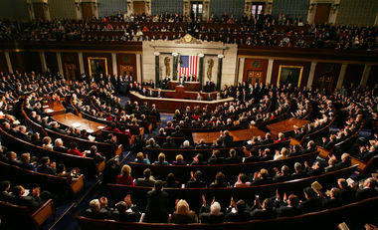
Questions?

