Slide 1
Alternative Paths to the Air Force
Colonel Steve Staso
USAFA ALO

Slide 2
Becoming an Officer after Enlisting in the Air Force
Enlist in the Air Force 130 Air Force Careers http://www.airforce.com/
Apply for the “LEAD” Program for Officer training (No guarantee)

Slide 3
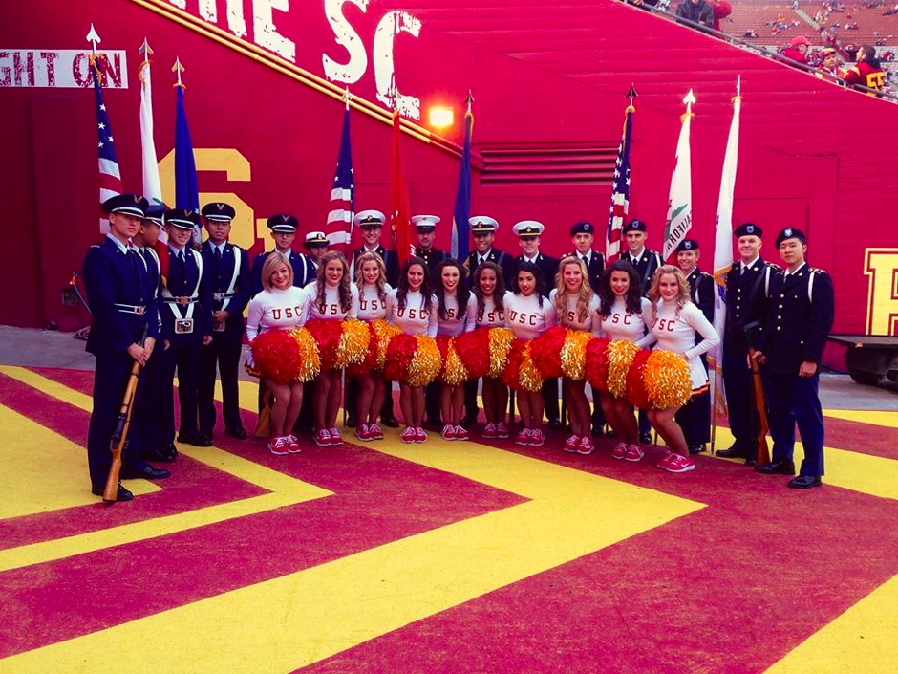
Becoming an Officer
Detachment 60 at LMU
Apply to a University that has an AF ROTC program Apply for AFROTC Scholarship – Apply by 1 Dec Enroll in Air Force ROTC class
http://afrotc.com - College Locator, majors, etc.

Slide 4
AFROTC Scholarships
Detachment 40 at LMU
Scholarship criteria:
SAT: 1180 for Math+CritReas / ACT: 26
GPA: 3.0
Fitness test: Crunches, Push-ups, 1.5 Mile run
Interview
Deadline to complete application – 31 December

Slide 5
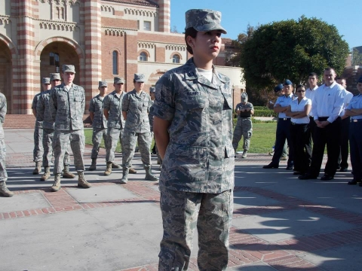
AFROTC Scholarships
Detachment 55 at UCLA
Scholarships Are Awarded for specific Majors
Most desirable majors
Electrical engineering, computer engineering, meteorology, nuclear physics and nuclear engineering
Foreign languages (Chinese, Russian, Korean, Arabic)
Pre-med, nursing and other medical-related

Slide 6
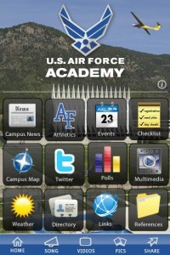
Following USAFA online
iPhone/Android App
AcademyAdmissions
@USAFA_Admission
@AcademyAdmissions
USAFA.Official
@AF_Academy

Slide 7
Notes:
Attacking USAFA patch will determine end of brief.

