Slide 1
Q & A With Recent Graduates
Capt Luke Ewing

Slide 2
WrAp UP Feedback Form

Slide 3
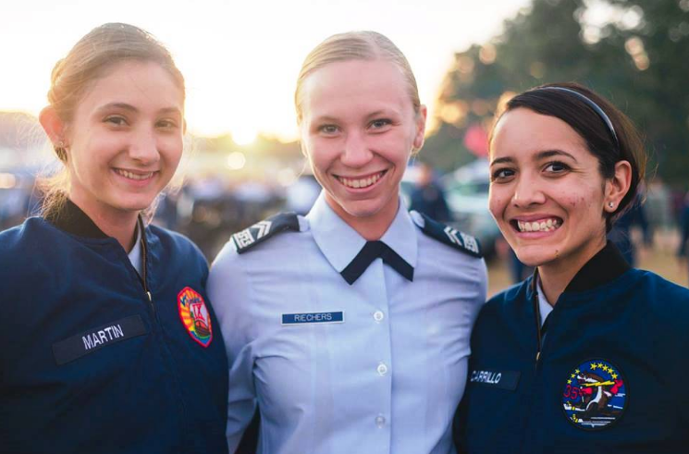
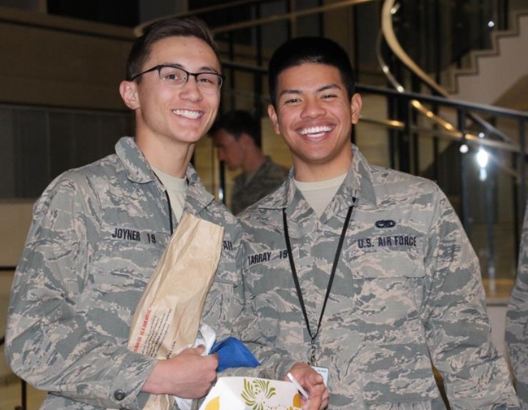
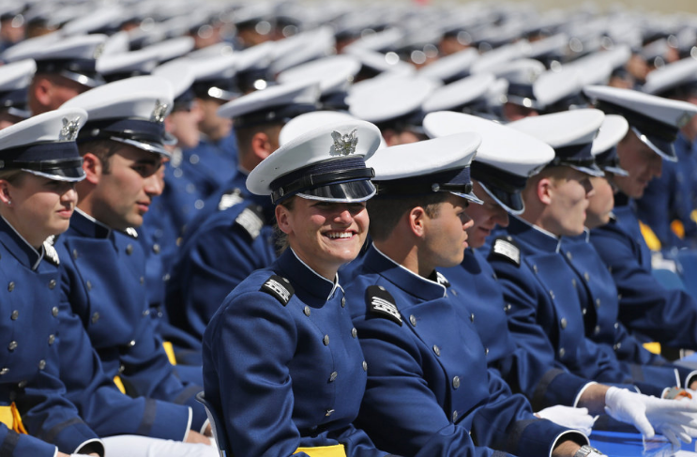
THANK YOU!
USAFA Admissions
Admissions
Liaison Officers
Los Angeles Area

